Slide 1


Slide 2
Colors

Slide 3


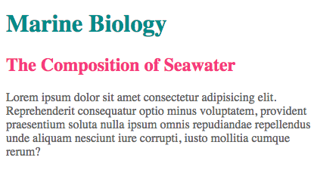

Foreground (Text) Color
The color property
Property value of color can be given in the following formats:
Color name
RGB value
HEX code

Slide 4

Understanding Colors
Three base colors (red, green, blue)
Each color is some mix of base colors
rgb(255, 255, 0) -> values from 0 to 255
#FFFF00 -> values from 0 to F
Color pickers can be used for getting these values
Convert from one type to another using converters
https://goo.gl/mTjNZv

Slide 5
Exercise

Slide 6
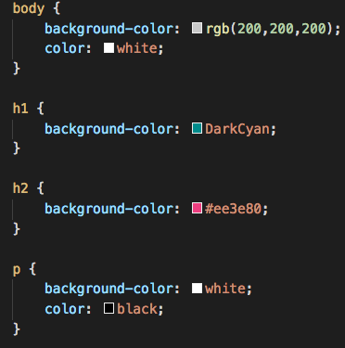
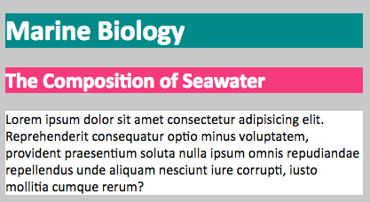
Background Color
Used to define the background color of an element
The background-color property
The value should be in one of the
following color formats

Slide 7
Exercise

Slide 8
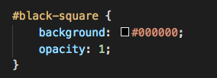



Opacity
The opacity property is used for defining element’s transparency
Opacity value can be between 0 and 1
0 – totally transparent
1 – no transparency

Slide 9

RGBA
RGB color + Alpha channel (transparency)
Transparency value can be between 0 and 1

Slide 10
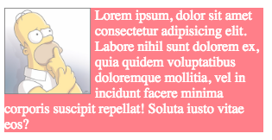
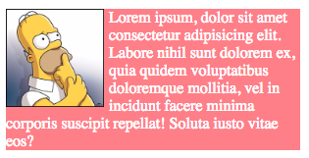
RGBA VS Opacity
Opacity applies transparency over an element
All nested elements will be transparent, too
RGBA is just adding transparency to the color

Slide 11
Exercise

Slide 12
Summary
There are three ways to specify colors in CSS: RGB values, hex codes, and color names
Color pickers can help you find the color you want
CSS3 has introduced an extra value for RGB colors to indicate opacity. It is known as RGBA.
It is important to ensure that there is enough contrast between any text and the background color

Slide 13
References
Color converter - https://goo.gl/mTjNZv

